Slide 1

Reverse Engineer Of the Domino’s Advertisement

Slide 2
STATEMENT
Domino’s pizza,Inc.Popularly known as “Domino’s” is the largest pizza restaurant chain in the world based on global retail sales,with more than 18,000 stores in over 90 markets.The following is the sample of Stock Market Data for the past two years.

Slide 3
HYPOTHESIS TEST
Days | Open | Close
1 | 254.89 | 255.96
2 | 256.12 | 256.45
3 | 257.45 | 257.7
4 | 256.61 | 257.52
5 | 257.27 | 258.94
6 | 258.74 | 256
7 | 256.65 | 263.6
8 | 263.03 | 271.75
9 | 272.36 | 269.46
10 | 267.45 | 263.18
X = Number of days (Discrete)
Y = Selling Prize (Contineous)
Confidence level= 95%
α = 0.05
It follows Paired ttest.

Slide 4
HYPOTHESIS TEST
Framing of Hypothesis : H0 ( μA = μB )There will be no difference.
: H1 ( μA ≠ μB )There will be difference.
From the hypothesis test : p = 0.56383( Value of p is greater than α )
So,it accepts the Null hypothesis(H0) .
There will be no difference of stock price at
market open and the closing of the day.

Slide 5
GRAPHICAL REPRESENTATION
Graphical representation of Stock price at the open and closing of the market.

Slide 6
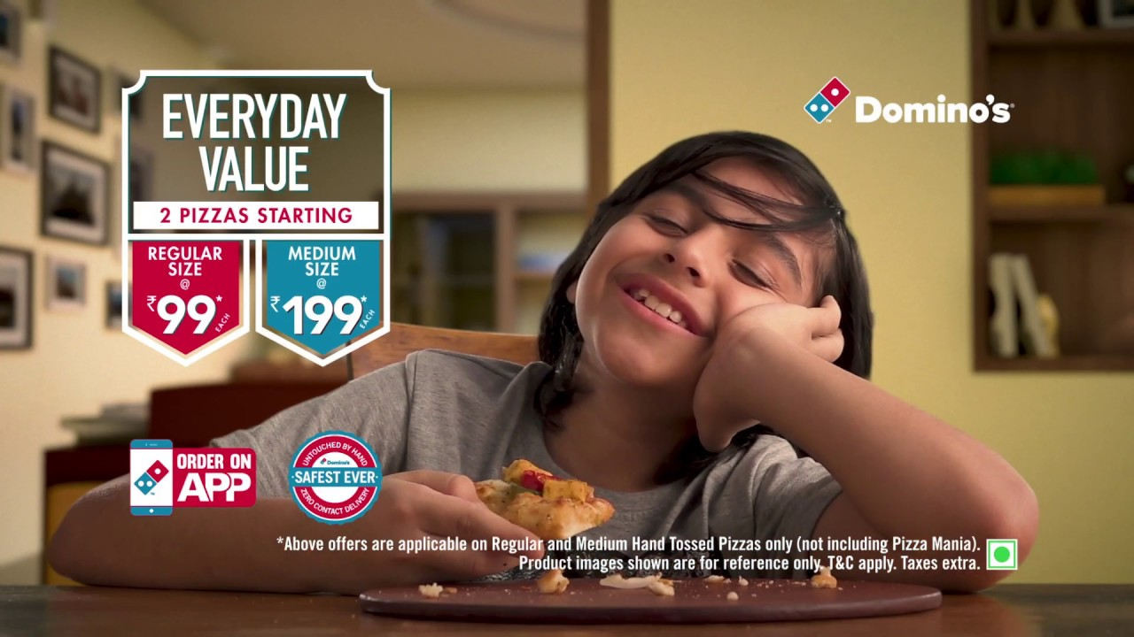
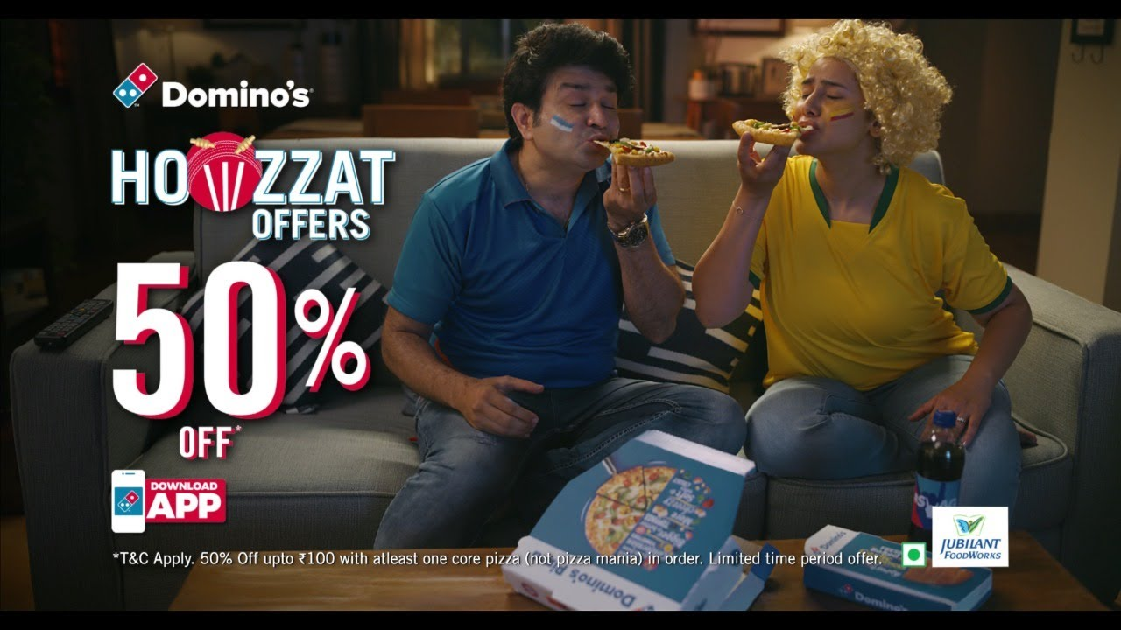


ADVERTISEMENT
The main target audience of Domino’s fast food franchise in india is between 18-35 in demographics.The target audience for Domino’s digital marketing straty is the larger portion of people who would end up buying a pizza with or with out a reason.

Slide 7
THANKYOU
Presented by, Mangena Suswetha

